Slide 1
Data Augmentation & Stellar Classification Using Various ML Algorithms
Robert Cervone-Richards, William Geddes, & Nikolay Popov
Notes:
Robert

Slide 2
What is stellar classification?
There are many different types of stars in the universe
The most common system for stellar classification is called the Morgan-Keenan (MK) system
This system includes seven categories: O, B, A, F, G, K, & M
The categories are roughly in order of temperature, but there is significant overlap and variation, so other features are necessary
Notes:
Robert

Slide 3
What is the significance of stellar classification?
There are many reasons why a scientist or astronomer would want to know what type of star they are looking at
Stellar classification can allow a scientist to predict how a star will evolve (for example, when it will go supernova)
Knowing the distribution of stars in a galaxy can help scientists understand the properties of the galaxy
Observing different types of stars and how they change over time can provide clues about how stars form
Notes:
Robert

Slide 4
Our original goal:
Our original goal was to apply six different ML algorithms to a dataset of stellar characteristics to see which one(s) performed the best
The first dataset we used was huge (10,000 data points) but classified unknown space objects as galaxies, stars, or quasars, which was not exactly what we wanted to do
We were able to find a labeled dataset which we could use for our goal of MK classification, but…
Notes:
Billy

Slide 5
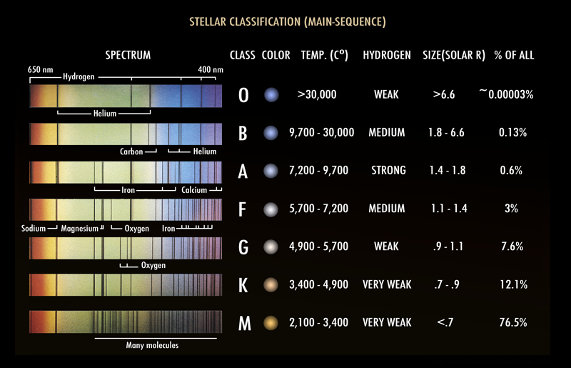
MK classification of main sequence stars
yikes
Notes:
Billy

Slide 6
Our main challenge:
Since there are so few “O” stars in the universe, there were very few “O” stars in the labeled dataset
Surprisingly, there were even fewer “K” examples in the dataset: only 1 out of 240 data points was a “K” star!
This made techniques such as cross-validation impossible, because we had more splits than “K” examples
Also, since 76.5% of all stars are “M” stars, 111 out of 240 data points were “M” stars
Notes:
Billy

Slide 7
Our new goal:
Apply four different ML algorithms to a dataset of stellar characteristics to see which one(s) performed the best
*AND*
Investigate different methods for data augmentation, since perfect (or even good) data can be hard to find
Note: All datasets used were normalized → z = (x - μ)/σ
Notes:
Niky
zscore: x is original value of feature
Mu is the mean of each feature
Sigma is standard deviation of each feature

Slide 8
Data Augmentation Method #1:
Over- and under-representation
Over-representation of under-represented classes:
First we simply copied and pasted the one “K” data point five times to be able to do 5-fold cross-validation
Then we found four extra “G” examples online and added them to the dataset, and copy/pasted again
Under-representation of over-represented classes:
Kept above changes *and* randomly deleted “M” examples
This actually made our results worse
* No synthetic data was “created” for this method
Notes:
Billy

Slide 9
Data Augmentation Method #2: Min-Max Ranged Data Generation
Using Kaggle Dataset
Using Online Data Ranges
Found ranges of feature values from found dataset
Used these to generate evenly distributed points for each class
Some overlap exists between classes
Looked up ranges for star feature values online
Plugged into Matlab script to generate table of evenly distributed points for each spectral class
Low overlap between classes
Ranges were distinct
Notes:
Robert

Slide 10
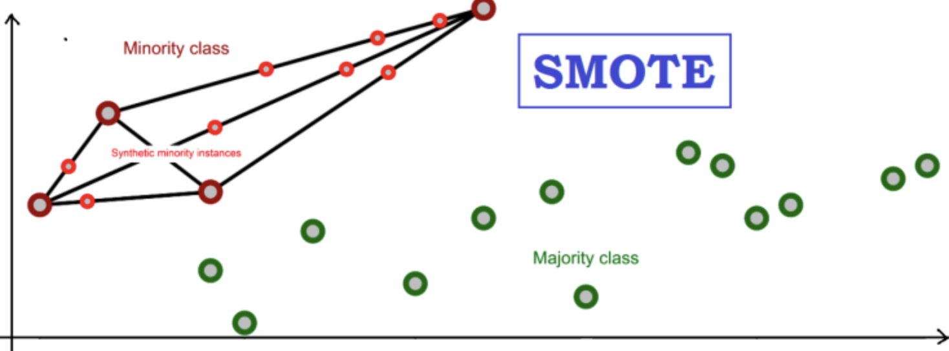
Data Augmentation Method #3:
Synthetic Minority Oversampling Technique (SMOTE)
x_{new}= x + 𝝀(z - x)
Notes:
Niky
SMOTE Operates on principle of generating new plausible datapoints, rather than duplicating instances of minority classes
I’ll give a brief overview of the algorithm:
SMOTE first selects a random sample from a minority class
Find k NN within the same class, randomly select one of them
Compute vector in feature space which connects that selected sample to its neighbor
New sample is synthesized along this line by:
Taking the distance between the chosen neighbor and sample (z-x), multiply the difference by a random number between 0-1 (lambda), add this value to the feature vector of the chosen sample

Slide 11
kNN Results
Dataset | Samples of each label | CCR | Notes
MK csv #1 | M: 111; B: 46; O: 40; A: 19; F: 17; K: 6; G: 1 | 79% | Original dataset
MK csv #2 | M: 111; B: 46; O: 40; A: 19; F: 17; K: 12; G: 10 | 81% | “G” examples harvested from Internet; “K” & “G” examples copy/pasted
MK csv #3 | M: 61; B: 46; O: 40; A: 19; F: 17; K: 12; G: 10 | 76% | Random “M” examples deleted
Artificial Data Method 1 | M: 211; B: 146; O: 140; A: 119; F: 117; K: 306; G: 1 | 71%
Artificial Data Method 2 | M: 400; B: 400; O: 400; A: 400; F: 400; K: 400; G: 400 | 99.7%
MK SMOTE | M: 111; B: 111; O: 111; A: 111; F: 111; K: 111; G: 0 | 78% | +Synthetic Data Points
Notes:
Billy

Slide 12
GBM Results
Dataset | Samples of each label | CCR | Notes
MK csv #1 | M: 111; B: 46; O: 40; A: 19; F: 17; K: 6; G: 1 | 89% | Original dataset
MK csv #2 | M: 111; B: 46; O: 40; A: 19; F: 17; K: 12; G: 10 | 92% | “G” examples harvested from Internet; “K” & “G” examples copy/pasted
MK csv #3 | M: 61; B: 46; O: 40; A: 19; F: 17; K: 12; G: 10 | 85% | Random “M” examples deleted
Artificial Data Method 1 | M: 211; B: 146; O: 140; A: 119; F: 117; K: 306; G: 1 | 94%
Artificial Data Method 2 | M: 400; B: 400; O: 400; A: 400; F: 400; K: 400; G: 400 | 99.8%
MK SMOTE | M: 111; B: 111; O: 111; A: 111; F: 111; K: 111; G: 0 | 97% | +Synthetic Data Points
Notes:
Billy: parameters = # boosting stages, learning rate, max depth of each tree in the ensemble, etc.

Slide 13
SVM Results
Dataset | Samples of each label | CCR | Notes
MK csv #1 | M: 111; B: 46; O: 40; A: 19; F: 17; K: 6; G: 1 | 83.1% | Original dataset
MK csv #2 | M: 111; B: 46; O: 40; A: 19; F: 17; K: 12; G: 10 | 94.2% | “G” examples harvested from Internet; “K” & “G” examples copy/pasted
MK csv #3 | M: 61; B: 46; O: 40; A: 19; F: 17; K: 12; G: 10 | 86.8% | Random “M” examples deleted
Artificial Data Method 1 | M: 211; B: 146; O: 140; A: 119; F: 117; K: 306; G: 1 | 86.3%
Artificial Data Method 2 | M: 400; B: 400; O: 400; A: 400; F: 400; K: 400; G: 400 | 100%
MK SMOTE | M: 111; B: 111; O: 111; A: 111; F: 111; K: 111; G: 0 | 92.7% | +Synthetic Data Points
Notes:
Niky
-SVM multiclass classification done via All Pairs method
-Grid search was used to tune regularization parameter
-different kernel types, rbf, linear were explored → linear was the best

Slide 14
Random Forest Results
Dataset | Samples of each label | CCR | Notes
MK csv #1 | M: 111; B: 46; O: 40; A: 19; F: 17; K: 6; G: 1 | 92% | Original dataset
MK csv #2 | M: 111; B: 46; O: 40; A: 19; F: 17; K: 12; G: 10 | 90% | “G” examples harvested from Internet; “K” & “G” examples copy/pasted
MK csv #3 | M: 61; B: 46; O: 40; A: 19; F: 17; K: 12; G: 10 | 88% | Random “M” examples deleted
Artificial Data Method 1 | M: 211; B: 146; O: 140; A: 119; F: 117; K: 306; G: 1 | 98%
Artificial Data Method 2 | M: 400; B: 400; O: 400; A: 400; F: 400; K: 400; G: 400 | 100%
MK SMOTE | M: 111; B: 111; O: 111; A: 111; F: 111; K: 111; G: 0 | 98% | +Synthetic Data Points
Notes:
Robert

Slide 15
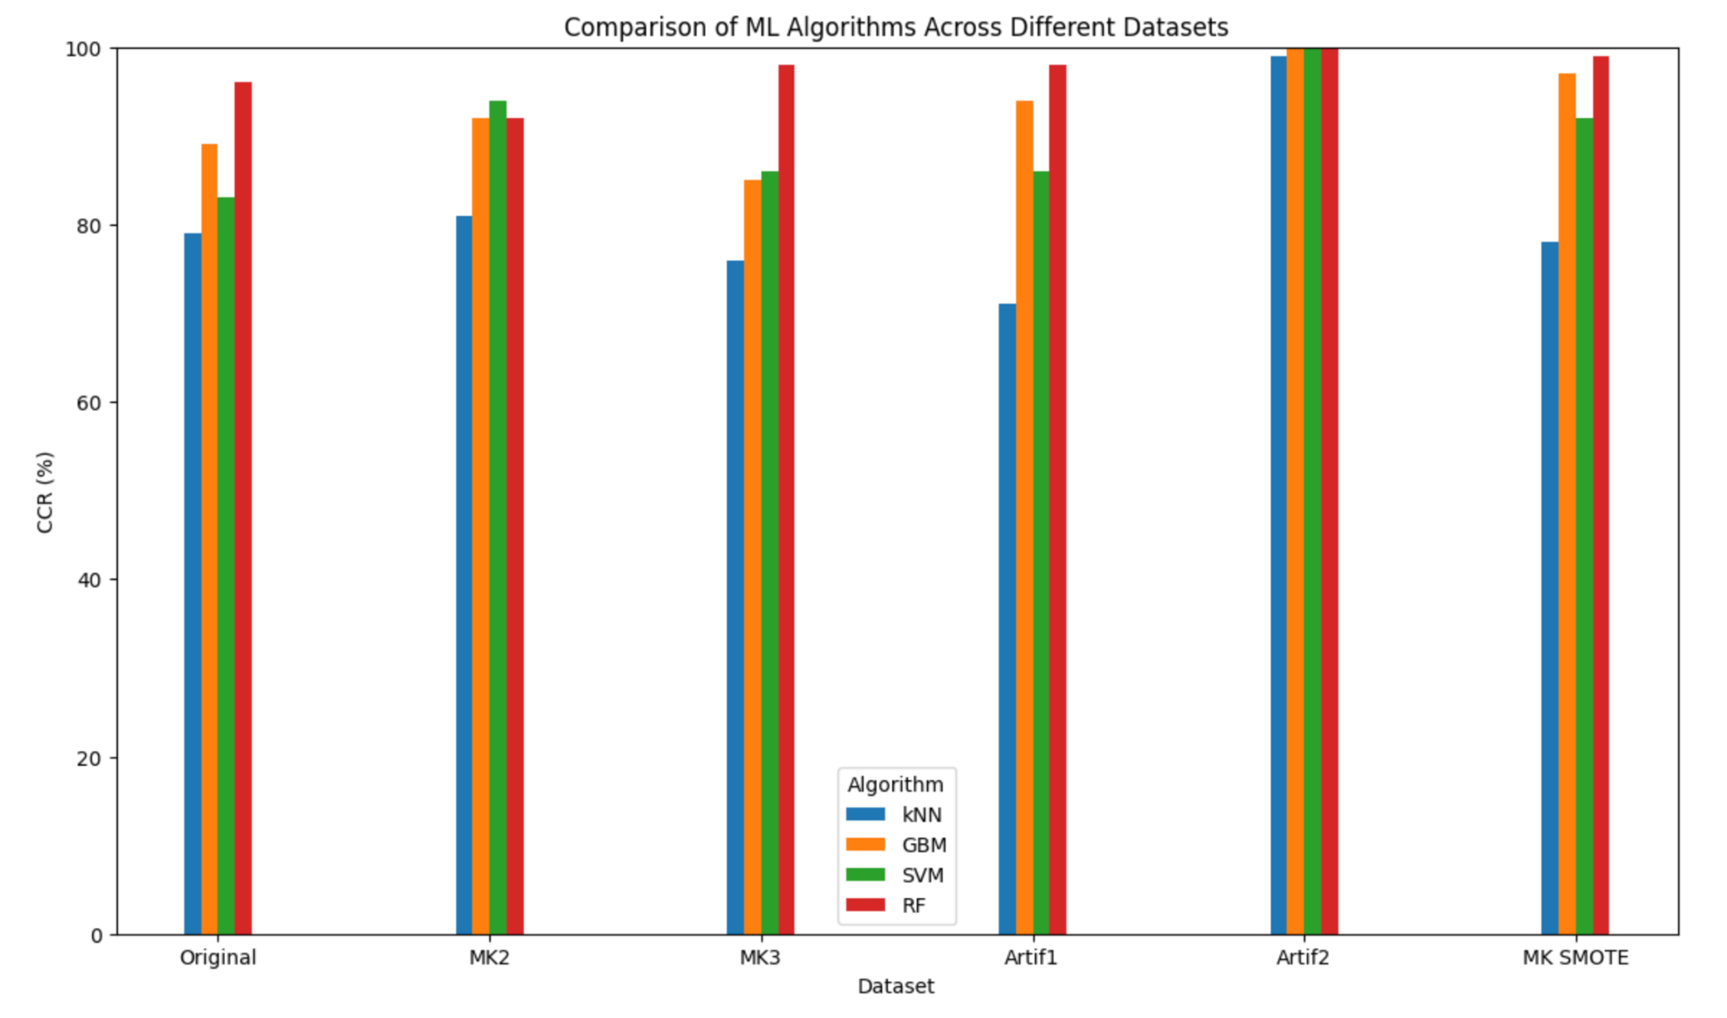
Final Histogram (CCR)
Notes:
Niky
-kNN performed the worst
-RF performance
-artif2 dataset performed the best, but likely b/c its overfitting

Slide 16
CCR Scores
Dataset | Samples of each label | kNN CCR | GBM CCR | SVM CCR | RF CCR
MK csv #1 | M: 111; B: 46; O: 40; A: 19; F: 17; K: 6; G: 1 | 79% | 89% | 83.1% | 92%
MK csv #2 | M: 111; B: 46; O: 40; A: 19; F: 17; K: 12; G: 10 | 81% | 92% | 94.2% | 90%
MK csv #3 | M: 61; B: 46; O: 40; A: 19; F: 17; K: 12; G: 10 | 76% | 85% | 86.8% | 88%
Artificial Data Method 1 | M: 211; B: 146; O: 140; A: 119; F: 117; K: 306; G: 1 | 71% | 94% | 86.3% | 98%
Artificial Data Method 2 | M: 400; B: 400; O: 400; A: 400; F: 400; K: 400; G: 400 | 99.7% | 99.8% | 100% | 100%
MK SMOTE | M: 111; B: 111; O: 111; A: 111; F: 111; K: 111; G: 0 | 78% | 97% | 92.7% | 98%
Notes:
Robert

Slide 17
F-1 Scores
Dataset | Samples of each label | kNN F-1 | GBM F-1 | SVM F-1 | RF F-1
MK csv #1 | M: 111; B: 46; O: 40; A: 19; F: 17; K: 6; G: 1 | 0.81 | 0.92 | 0.89
MK csv #2 | M: 111; B: 46; O: 40; A: 19; F: 17; K: 12; G: 10 | 0.82 | 0.94 | 0.94
MK csv #3 | M: 61; B: 46; O: 40; A: 19; F: 17; K: 12; G: 10 | 0.75 | 0.87 | 0.87
Artificial Data Method 1 | M: 211; B: 146; O: 140; A: 119; F: 117; K: 306; G: 1 | 0.72 | 0.96 | 0.93
Artificial Data Method 2 | M: 400; B: 400; O: 400; A: 400; F: 400; K: 400; G: 400 | 0.995 | 1.0 | 1.0
MK SMOTE | M: 111; B: 111; O: 111; A: 111; F: 111; K: 111; G: 0 | 0.76 | 0.98 | 0.96
Notes:
Robert

Slide 18
Final Histogram (F-1 Scores)
Notes:
Niky
-kNN performed the worst
-RF performance
-artif2 dataset performed the best, but likely b/c its overfitting

Slide 19
Conclusions
Stellar classification is an important and challenging task
Machine learning algorithms, such as the five we investigated, can be highly useful for stellar classification
However, good data is hard to find
Data augmentation techniques can improve the performance of machine learning algorithms and are not difficult to implement, nor do they increase computational complexity or algorithmic runtime
Notes:
Niky

